Slide 1
FILE READER AND FILE WRITER (File Handling in java)
NAME: HEENA SALIM SHAIKH

Slide 2
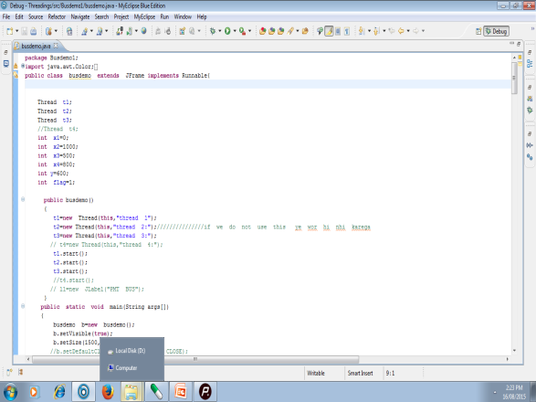
Java programming
INPUT => PROGRAM => OUTPUT
(code/statements
with various
methods and procedures)

Slide 3
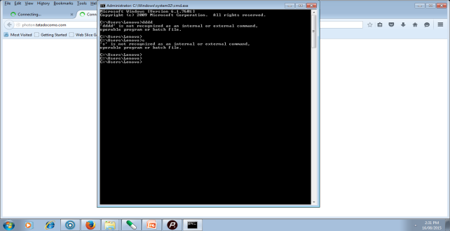
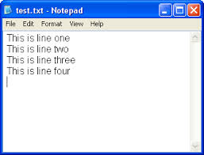
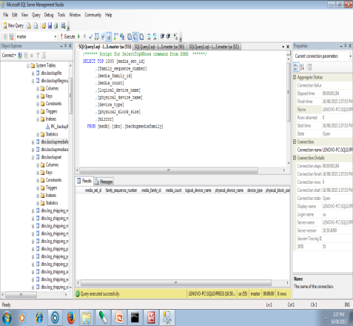
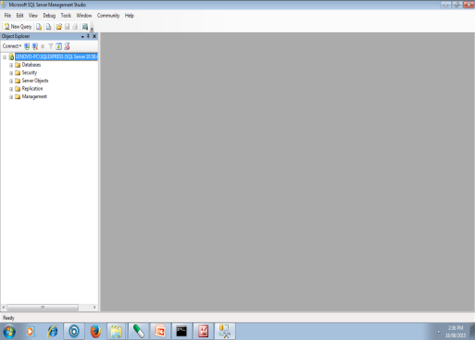
SUCH INPUT CAN BE GIVEN FROM
1>console
2>in the form of files
3>from database
4>from scanner
5>from ARRAY

Slide 4


WE CAN TAKE INPUT FROM FILES BY USING
Reader and Writer classes
FILE READER AND WRITER
FILEINPUTSTREAM AND FILEOUPUTSTREAM
FILEBUFFEREDREADER AND FILEBUFFEREDWRITER
AND MANY SUCH CLASSES
INPUT OUTPUT
I/O PACKAGE

Slide 5

Input from User
Unary or binary data
} chracter BY
OR character
OR
In stream form
output
“H”
E
E
L
L
O
“H”
E
E
L
L
O
101110011
1011111
100111111
10111011
101110111 byte
by byte
PROGRAM

Slide 6
FILE READER AND WRITER
file reader and writer use to take input in character form
Input
stream of characters
two bytes at atime
Program
output
A
N
Y
C
H
A
R

Slide 7


Read and write text files only
Disk=> text file => read /write

Slide 8





Cannot read or write
it cannot works on binary
data

Slide 9
JAVA FILE READER CONSTRUCTOR
FileReader F =FileReader(“file name in string format”);
Ex.FileReader f=new FileReader(“abc.txt”);
FileReader f1=new FileReader(“xyz”);
It gets filename in string. It opens the given file in read mode. If file doesn't exist, it throws FileNotFoundException.

Slide 10
INBUILT Methods of FileReader class
1) public int read()-
returns a character in ASCII form. It returns -1 at the end of file.
FileReader f = new FileReader(“abc.txt”);
opening file in read mode
Integer i=f.read(); Reading file Character by character
It is storing characters into ascii format
while((i!=1)
{
i=f.read();
Till end of file not reach
System.out.println((char)i); if i=1; END OF FILE
}
Integer converted into character

Slide 11
METHOD NO-2
2) public void close()
closes FileReader
After reading all data character by character by using close method we can close file
F.close();
}

Slide 12
In this example, we are READING the data from the file abc.txt file.
import java.io.*;
class Simple{
public static void main(String args[])throws Exception
{
FileReader f=new FileReader("abc.txt");
int i;
while((i=f.read())!=-1)
System.out.println((char)i);
f.close();
}
}

Slide 13
FILE WRITER
USE FOR WRITING INTO THE FILE

Slide 14
FILE WRITER CONSTRUCTOR
FileWriter f1=new FileWriter(“ file name is in string format”)
creates a new file.
Examples
FileWriter f=FileWriter (“pqr.txt”);
It will create new file with name pqr

Slide 15
Inbuilt Methods Of File Writer Class
1) public void write(String text)
writes the string into FileWriter.
Example =>f.write(“HELLO HOW ARE U WATS APP”);
2) public void write(char c)
writes the char into FileWriter.
Example => f.write(H);
3) public void write(char[] c)
writes char array into FileWriter.
Example => f.write(H,E,l,l,o,j,A,V,a,I,e,r,s);

Slide 16
1
4) public void flush()
flushes the data of FileWriter.
EXAMPLE=>f.flush();
5) public void close()
closes FileWriter.
EXAMPLE=>f.close()

Slide 17
PRAGRAM this example, we are writing the data in the file pqr.txt.
===========================================
import java.io.*;
class Simple{
public static void main(String args[]){
try{
FileWriter f=new FileWriter(“pqr.txt");
Creating new file
f.write("my name is HEENA "); // u can specify path of another file here to copy it into newly created file
f.close(); } for closing file
}

Slide 18
!
catch(Exception e)
{
System.out.println(e);} }
try and catch block is surrounded to code so as to throw Exception in case of copying or user forget to include name of file to be created
System.out.println("success");
}
}

Slide 19

THIS WHOLE ABOUT FILE READER AND WRITER

Slide 20
The Major Difference Between File Reader Writer And File Inputstream And Outputstream
FILE READER AND WRITER 1> INPUT OUTPUT | FILE INPUTSTREAM AND OUTPUTSTREAM INPUT => OUTPUT | FILEBUFFEREDREADER AND BUFFERED WRITER INPUT => ”; (: # 1 1 “C O M PU T E R” // || H 5 { } J “ A ?” OUTPUT
H E L L O
1 01011010
E
L
O
BUFFER
E
L

Slide 21
The Major Difference Between File Reader Writer And File Inputstream And Outputstream
FILE READER AND WRITER 2> TEXT FILES ONLY | FILE INPUTSTREAM AND OUTPUTSTREAM BINARY FILES Audio files mp3 files Image files (jpegs and pngs JPG ) Video files (mp4 ) Compressed files (e.G. ZIP files) .exe files LES | FILEBUFFEREDREADER AND BUFFERED WRITER BOTH TEXT AND BINARY FILES CAN BE BUFFERED

Slide 22
DIFFRENCE
FILE READER AND WRITER 2> | FILE INPUTSTREAM AND OUTPUTSTREAM BINARY FILES | FILEBUFFEREDREADER AND BUFFERED WRITER
3> LOW PERFORMANCE 4> CLASS USE= FILEREADER FILEWRITER | GOOD AS COMPARE TO FILE READER AND WRITER 4>CLASS USE= FILEINPUTSTREAM FILEOUTPUTSTREAM | BEST PERFORMANCE 4> CLASS USE= FILEBUFFEREDREADER FILEBUFFEREDWRITER

Slide 23
Example-Reading and writing File's content using FileInputStream & outputstream
public class HowToReadFileInJava {
public static void main(String args[]) {
try {
FileInputStream f = new FileInputStream(“abc.txt");
FileOutputStream f1=new FileOutputStream(“pqr.txt”);
while (i != -1) {
int i = f.read(); //first reading the file abc.txt using f
f1.write((char)i); //we are writing into pqr.txt using f1
f.close(); } }
catch (IOException e)
{
System.out.println("Failed to read binary data from File");
e.printStackTrace();
}

Slide 24
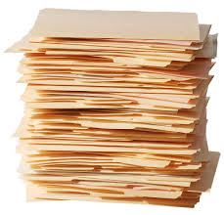
THANK YOU!!!!

Slide 25



ANY QUESTION??

